Slide 1
Industrial Sales
Presentation
October 2016

Slide 2
Castrol® Industrial - Introduction

Slide 3
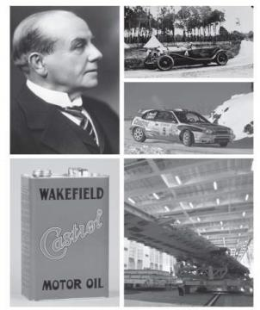
History
Our knowledge allows us to select and apply the best product that most positively impact productivity, quality and costs in your manufacturing operations
100+ years’ experience in a range of lubricants and metalworking fluids
20+ years’ experience in fluid and lubrication management services
Global business with a network of sales, engineering, research and manufacturing capabilities in more than 50 countries

Slide 4
OEM Relationship
Strong partnership with leading OEMs
Castrol products have approvals and recommendations from major OEMs
New product developments through interaction with OEMs
Knowledge about latest application and technology trends from OEMs

Slide 5

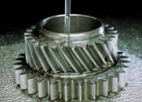


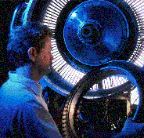
Key Focus Segments
Automotive manufacturing
Machinery Manufacturing
Wind Energy
Metals
Aerospace

Slide 6




















Key Customers

Slide 7



Manufacturing and Technology
Moenchengladbach, Germany
Péronne, France
Landau, Germany
Taicang, China
Naperville, Illinois
Warminster, Pennsylvania
Shanghai, China
Castrol Industrial Technology Centers
Castrol Industrial Manufacturing Centers

Slide 8
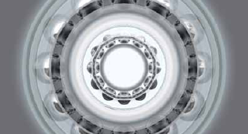
Vision
We will provide our customers with Recognizable Value based on Products and Services; which will be delivered by Professionals in an Ethical and Responsible manner

Slide 9
Castrol® Industrial – Value Added Approach

Slide 10
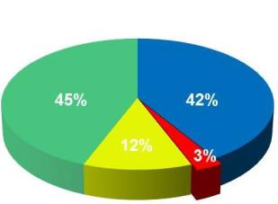

Operating Costs
Typical Manufacturing Budget
The right lubricants can reduce operational costs
Affected process
The largest single budget
Affected process
costs are typically
item is typically tooling costs
costs are typically
8
8
-
-
12 times the
which are directly affected by
12 times the
chemical spend
metal working fluids
Chemical
chemical spend
Chemical
Spend
Spend
Component
Component
Equipment
Productivity
Equipment
Productivity
Life
Life
Availability
Availability
Housekeeping
Housekeeping
Disposal
Disposal
Labor
Labor
Costs
Costs
Costs
Costs
Insurance Costs
Insurance Costs
Warehousing
REPLACEMENT PARTS
Warehousing
Inventory
Inventory
LUBRICANTS/CHEMICALS
Handling
Handling
Safety
Safety
Issues
Issues
MISC. SUPPLIERS/EQUIPMENT
MAINTENANCE LABOR
Notes:
Let’s look at it this way…what do businesses do with their limited supply of funds? Industry figures indicate that chemical expenditures are typically less than 3% of an average manufacturing overhead and maintenance budget. Given that, we start with what is commonly thought of as the only material impact of fluids: product price and volume. If you want to save money on fluids, all you can do is buy it for less…or buy less of it, right? Perhaps. However, thinking about those touch points, these chemicals can have the most direct impact on equipment, moving components, and the people who work with them that make up the remaining 97% of the pie. Maintenance of that fluid takes form of testing, replacement fluid, and additives. Then there is disposing of that material when we are done or when it has reached its useful life. What about tool life, labor costs, worker safety? Those are key statements, because those boundaries aren’t the same for every fluid. This is where chemical technology comes into play. Like I said, this little slice of the budget can have a lasting, material impact on your bottom line. Now we’re starting to change that initial focus on fluids as a cost of doing business….and turning it into an investment in your business. Let’s see how the process works….

Slide 11

The Castrol® Approach
Our goal is to deliver the lowest TOTAL COST of OWNERSHIP (TCO) to the customer
TO MAXIMIZE YOUR PRODUCTIVITY AND MINIMIZE YOUR COSTS WE LOOK AT THE BIG PICTURE
=
+
TOTAL COST OF OWNERSHIP (TCO)
TOTAL LUBRICANT
COST
TOTAL PROCESS
COST
Most suppliers only focus on price with little concern for all the other costs
Price
Annual usage
Lubricant life
Additives
Inventory costs
Shipping
Surcharges
Productivity
Maintenance
Replacement parts
Quality
Downtime
Labor
Lubricant waste

Slide 12
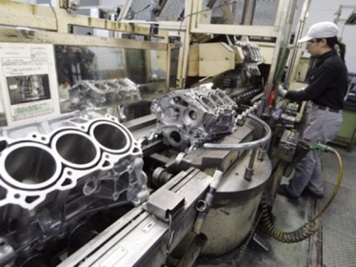
Impact on Productivity, Quality & Tool Life
Overall Equipment Effectiveness (Availability x Performance x Quality)
Increased Cycle Speed
Improved Quality
Reduced Downtime
Tool Life Savings
Lubrication
Flushing
Stable Chemistry
Quality / Rework Reduction
Surface Finish
Component Cleanliness
RP / Staining
Operator Acceptance

Slide 13
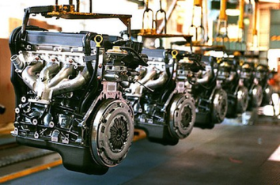
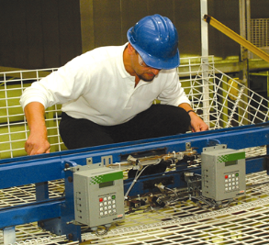
Impact on Maintenance
Process Fluids
Turn Over & Top-up Rates
Recycling & Recovery Technologies
Filtration
Additive Usage & Alt. Technology
Lubrication
Parts Replacement / Re-build
Oil Life
Equipment Uptime
Labor Efficiency

Slide 14
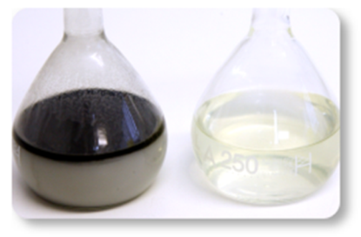
Impact on Facilities & Waste
Fluid Recovery (Swarf)
Swarf Segregation & Value Efficiencies
Fluid Waste Stream Optimization
Landfill Avoidance
Waste Treatment
Ultra Filtration (UF)
Micro
Bio Reactor
Water Conditioning

Slide 15
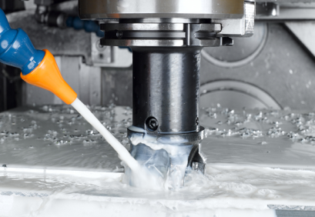
Impact on Environment & Energy
Reduce Heating Requirement
Reduce Cooling Requirement
Reduce Misting
Leak Detection
Hydraulic oil
Compressed air
Machine Tool Energy Consumption

Slide 16
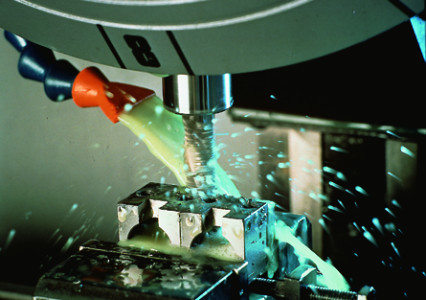
Impact on Process Fluid Optimization
Fluid Rationalization
Stock Management
Inventory Systems & Technology
Pack Sizes
Globally Available
Insurance Savings
OEM Approvals
Legislation Compliance

Slide 17





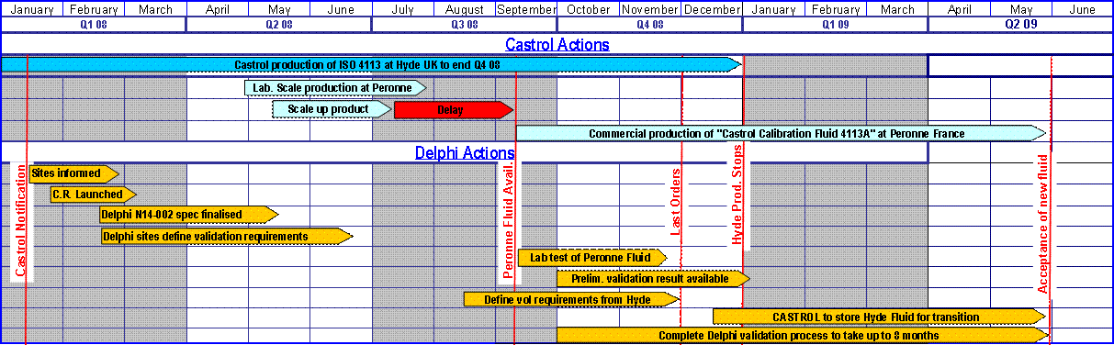

Castrol® TCO Process
Introduction to Castrol TCO
Understanding Needs
Plant Survey
Value Presentation
Fluid Trial
Trial Review & Commitment
Implementation Timeline

Slide 18
Value Inside Calculator Tool

Slide 19
Value Inside Calculator
Castrol tool for determining the true Total Cost of Ownership (TCO)
Survey
Savings
Initial Fill
Extended oil drain intervals (usage)
Equipment Repair
Parts replacement costs
Labor and Downtime
Improved Uptime
Increase Overall Equipment Effectiveness
Minimize Downtime
Waste treatment
Waste volume decrease
Ease of disposal
Additives
Lower additive dosage
Decreased monitoring and troubleshooting
Quality
Lower part rejects due to equipment failure
HSSE
Free of heavy metals or water pollutants

Slide 20
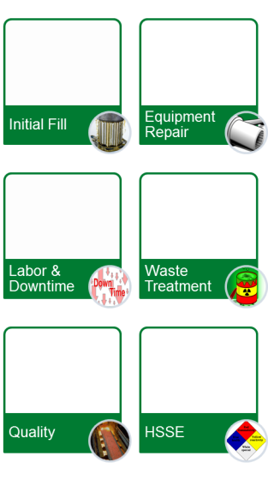
Value Inside Calculator – Cost Comparison & Savings
Compare the following cost centers
Initial Fill Cost Comparison
Waste Treatment Cost Comparison
Equipment Repair Cost Comparison
Downtime Cost Comparison
Total Lubricant Related Costs
$$
$$$
$$$
$
$$
$
Notes:
Similar gains can be had with equipment maintenance and lubrication.
Initial Fill: Extended oil drain intervals and lower usage
Equipment Repair: Less part replacement costs
Labor and Downtime: Improved uptime and OEE; less labor for equipment repair/replacement and lubricant changeouts
Waste treatment: less volume to waste and ease of disposal
Additives: lower additive usage; less monitoring and troubleshooting
Quality: less part rejects due to equipment failure
HSSE: added safety benefits such as fire resistance and free of heavy metals or water pollutants

Slide 21
Castrol® Products

Slide 22
Castrol® Industrial Product Portfolio - Applications
Best-in-Class and Designed to Drive Cost Savings and Productivity
Cleaners
Immersion
Maintenance
Spray wash
Ultrasonic
Corrosion Preventives
Oil-based
Solvent-based
Aqueous
Wax emulsions
Cutting & Grinding
Bio-Based Fluids
Synthetics
Semi-synthetics
Soluble oils
Straight oils
Deformation
Dry-film
Pastes
Semi-synthetics
Soluble oils
Straight oils
Synthetics
Bio-Based
Tapping fluids
Vanishing oils
Equipment
Conveyor lubricators
Lubrication systems
Greases
Heavy duty greases
High temperature greases
Low temperature greases
Open gear greases
Industrial Lubricants
Air tool oils
Assembly pastes
Compressor oils
Chain oils
Gear oils
Hydraulic oils (petroleum)
Hydraulic oils (fire resistant)
Slideway lubricants
Bio-Based oils
Specialty Lubricants
Oil-based
Water-based
Specialty Greases
Anti-lock brake system greases
Air leveler, boot lubricant
Bearing greases
High temperature greases
CV joint greases
Flourolubricants and solvents
Hydraulic clutch lubricants
Notes:
Product line card

Slide 23

Castrol® Industrial Performance Bio
High Performance and Environmentally Responsible Fluids
Reduce your environmental impact through:
Lower usage rates & fluid longevity
Renewable resource products
A range of better choices
Heavy metal, formaldehyde, chlorine and boron free products
Waste treat-ability of fluid formulations
Process compatible products with improve treat ability
Product Stewardship
Improve operating health by:
Elevated Flashpoints
Reduced microbial activities
Improved anti-misting characteristics
Decreased dermal sensitivity
Elimination of smoke in atmosphere
HSSE best practice sharing
Cutting and Grinding Oils
Bio NC Plus
Bio NC Lite
Bio NC Ultra Lite
Bio NC Super Lite
Bio NC Ultra Lite EP
Maintenance Oils
Bio SW PBL (slideway)
Bio HE PBL (hydraulic)
Forming Fluids
Bio DF R40
Specialty Oils
Bio NC MQL
Bio NC Thread

Slide 24




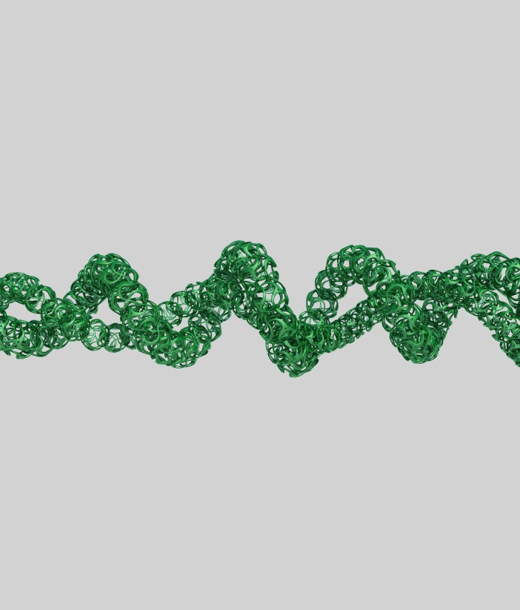
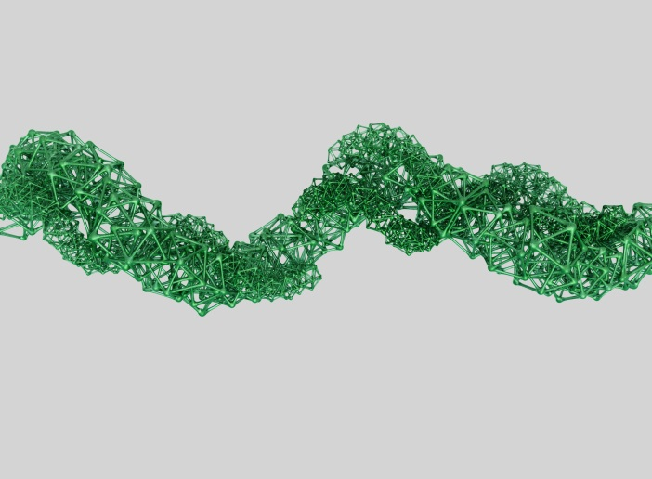

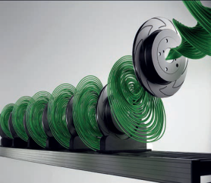
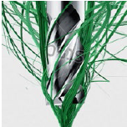
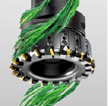

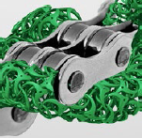
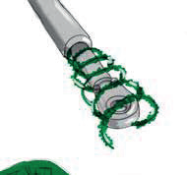
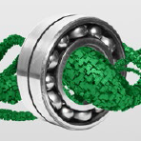
Castrol® Industrial - Strategic Brands
HYSOL
ALUSOL
SYNTILO
OPTIGEAR
TRIBOL
BRAYCO
MOLUB-ALLOY
STABILITY
PRECISION
SPEED
EFFICIENCY
RELIABILITY
EXTREME ENVIRONMENT
STRENGTH

Slide 25
Hysol®
Long lasting fluids for system stability
PROBLEM SET UP
In ferrous alloy metalworking operations leaching of alloy components can lead to instability in the fluid emulsion. Systems can fail due to growth of bacteria in these contaminated fluids and require interventions.
1
2
REASON TO BELIEVE
Specially formulated lubricant with resilient additive
technology to maintain system performance and
fluid life.
3
UNIQUE SELLING PROPOSITION
Long lasting fluids for system stability.

Slide 26
Alusol®
Precision performance in aluminum machining
1
PROBLEM SET UP
Producing precision components in aluminum is
difficult because of edge build up on the tool, which
can cause quality issues from the very first cut.
2
REASON TO BELIEVE
Technology formulated to ensure precise delivery
of Castrol lubricity additives to the cut which virtually eliminates
aluminum build up at the tool, even at lower concentrations.
3
UNIQUE SELLING PROPOSITION
Precision Performance in Aluminum Machining.

Slide 27
Syntilo®
High speed performance with better finishing and tool life
1
PROBLEM SET UP
High speed operation creates extreme heat at the cutting edge – over 1000°C – which is difficult to cool and lubricate, damaging the component and the tool.
2
REASON TO BELIEVE
A clean synthetic fluid technology that cools like water to
reduce extreme heat while lubricating at the cutting edge.
3
UNIQUE SELLING PROPOSITION
High speed performance with better finishing and
tool life.

Slide 28
Optigear®
Low friction gear oils that optimize efficiency
1
PROBLEM SET UP
Gearbox friction can generate excessive heat which puts
thermal stress on system components and propagates
wear and pitting to reduce operational efficiency.
2
REASON TO BELIEVE
Optigear’s advanced formulation containing MFT Plastic
Deformation has proven to lower the (coefficient of)
friction by up to 60% compared to standard gear oils,
to reduce gearbox operating temperatures and actively
resist wear and pitting.
3
UNIQUE SELLING PROPOSITION
Absolute performance in extreme environments.

Slide 29
Tribol®
Adaptive protection for equipment reliability
1
PROBLEM SET UP
More than 60% of all mechanical failures are lubrication
related, the majority of which are caused by wear and
surface degradation.
2
REASON TO BELIEVE
Advanced industrial lubricants containing active
molecules that adjust to the operating conditions
to protect components, reduce wear and unplanned failures.
3
UNIQUE SELLING PROPOSITION
Adaptive protection for equipment reliability.

Slide 30
Brayco®
Absolute performance in extreme environments
PROBLEM SET UP
Where the boundaries of possibilities are being pushed,
failure is not an option because the equipment being
used at the limits is hugely expensive and difficult
to replace.
1
2
REASON TO BELIEVE
Brayco’s range of high performance products are
designed for applications in extreme environments –
from the seabed to Mars.
3
UNIQUE SELLING PROPOSITION
Absolute performance in extreme environments.

Slide 31
Molub-Alloy®
Strongest lubricants for the heaviest loads
1
PROBLEM SET UP
Under the heaviest loads, the stress exerted can cause
standard lubricants to break under the pressure, risking
equipment damage or failure.
2
REASON TO BELIEVE
High performing lubricants containing solids that provide a protective layer that absorbs pressure, preventing component failure.
3
UNIQUE SELLING PROPOSITION
Strongest lubricants for the heaviest loads.

Slide 32
Metalworking Fluids

Slide 33
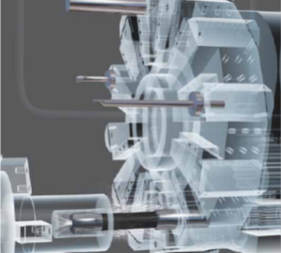
Metalworking Fluids
With the emphasis on your process reliability, we can offer a comprehensive range of premium metalworking fluids. Castrol’s extensive knowledge and experience in your application across various industries will help you improve quality and productivity at reduced overall process cost.
Cutting & grinding fluids
Soluble coolants
Synthetic coolants
Neat cutting & grinding oils
Corrosion preventives
Cleaners
Deformation process fluids

Slide 34
Hysol® MB Series – Water Soluble Coolant

Slide 35
Hysol® MB 50
Castrol’s #1 Selling Coolant
Robust multi-metal, multi-purpose soluble coolant designed for aluminum and ferrous alloy machining
Heavy duty machining applications
Chlorine-free
Formaldehyde releasing agent free
Suitable for aerospace market and automotive industry
Used in centralized systems as well as single sump machines
Highest volume Castrol Industrial fluid
MB 10 and MB 20 variants for less stringent applications

Slide 36
Hysol® MB Series - Castrol’s Best Selling Coolants
PRICE
PERFORMANCE
OIL LEVEL
Hysol MB 50
Hysol MB 20
Hysol MB 10
All have excellent bio-resistance & long sump life

Slide 37
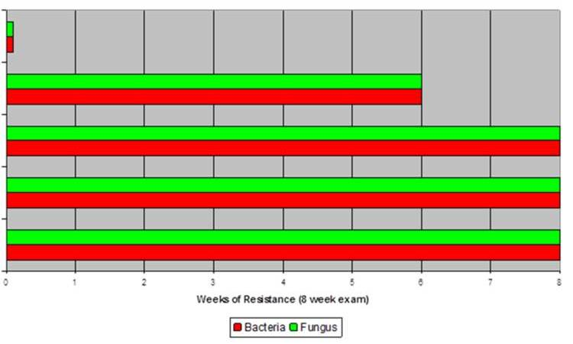
Hysol® MB series - Bio-Resistance
Conventional
Soluble
Product T
Hysol MB 10
Hysol MB 20
Hysol MB 50

Slide 38
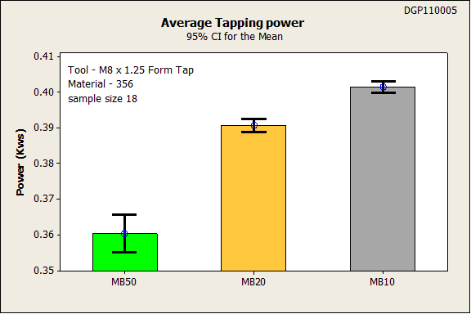
Hysol® MB Series – Machining Performance
Notes:
Here are results from a machining center study we conducted with Hysol MB 10, 20, and 50. It is shows the average power needed to form tap 18 holes in automotive aluminum.
As you can see, Hysol MB 10 required the most power to tap the holes and implies there is more friction between the part and the tool.
Hysol MB 20 showed a 5% reduction from Hysol MB 10. Hysol MB 50 an additional 5% reduction.
What does this mean?
Hysol MB 10 can do light duty machining of steel and aluminum – grinding, sawing, turning
Hysol MB 20 moderate duty – milling, drilling
Hysol MB 50 heavy duty - broaching, tapping, reaming
If you have any doubt about which product to use in an application – contact our application engineering team or help desk.

Slide 39
Alusol® AU Series – Semi-Synthetic Coolant

Slide 40
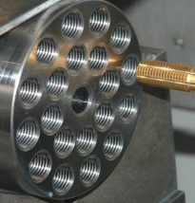


Top Tier Semi Synthetics - Alusol® AU Series
Top performing Aluminum machining Fluids
Alusol AU 68
Premium multi-metal machining product
Cleanest running semi-synthetic
Exceptional tool life and surface finish
Free of secondary amines, boron, & chlorine
Alusol AU 70
Contains additional ester
Incorporates EP additive
Maximum performance for aerospace applications

Slide 41
Alusol® AU 68 – Features/Benefits
Multi-metal compatible for aluminum, yellow metals, stainless, and aerospace materials
Potential to consolidate multiple fluids into one
Low surface tension for maximum wettability, low foam, no chip float, brighter chips and clean machines
Reduced consumption, reduced entrained air, efficient chip removal
Free of chlorine, secondary amines, boron, and nitrites
Worker safety consideration and compliance with HSE
Suitable for single sump machines and central systems

Slide 42
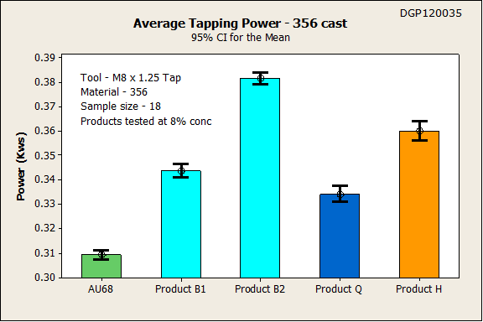
Machining Performance vs. Competition
Aluminum Cast 356 – Form Tapping Power Draw

Slide 43
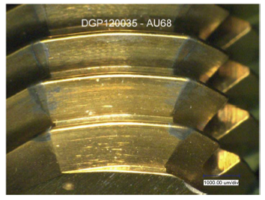
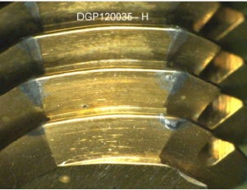
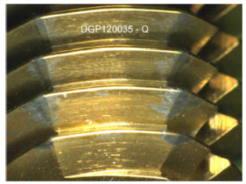
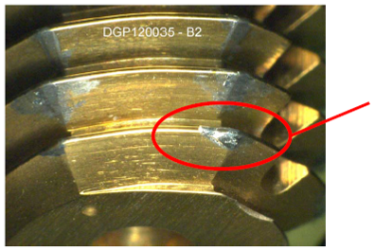
Machining Performance vs. Competition
Aluminum 356 – Tool Condition
Alusol AU 68
Very low built-up edge
Competitor H
Significant built-up edge
Built-up edge
Competitor Q
Built-up edge forming
Competitor B2
Heavy built-up edge

Slide 44
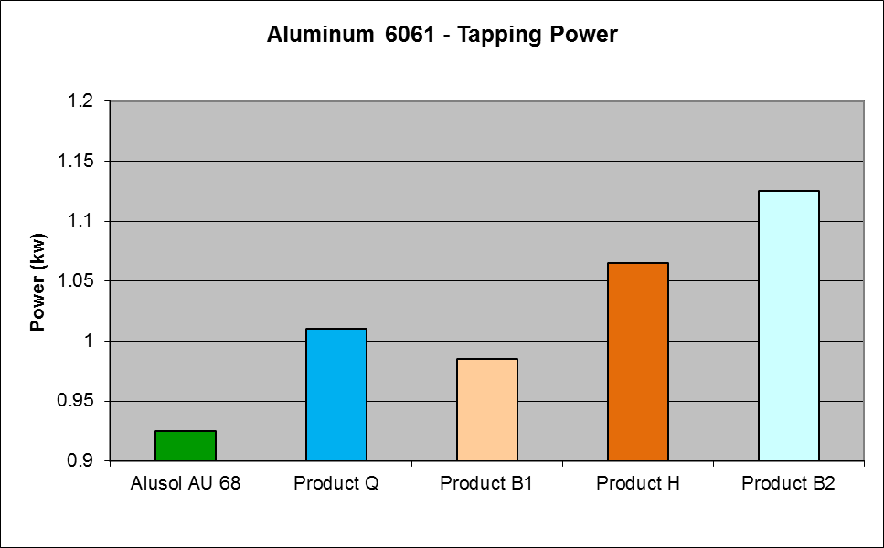
Machining Performance vs. Competition
Aluminum 6061 – Form Tapping Power Draw

Slide 45
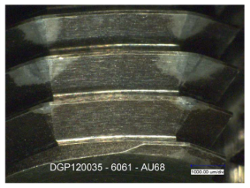
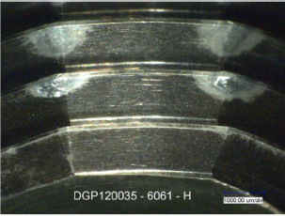
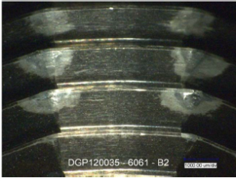
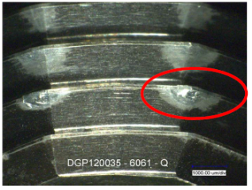
Machining Performance vs. Competition
Aluminum 6061 – Tool Condition
Alusol AU 68
Very low built-up edge
Competitor H
Significant built-up edge
Competitor B2
Heavy built-up edge
Built-up edge
Competitor Q
Heavy built-up edge

Slide 46
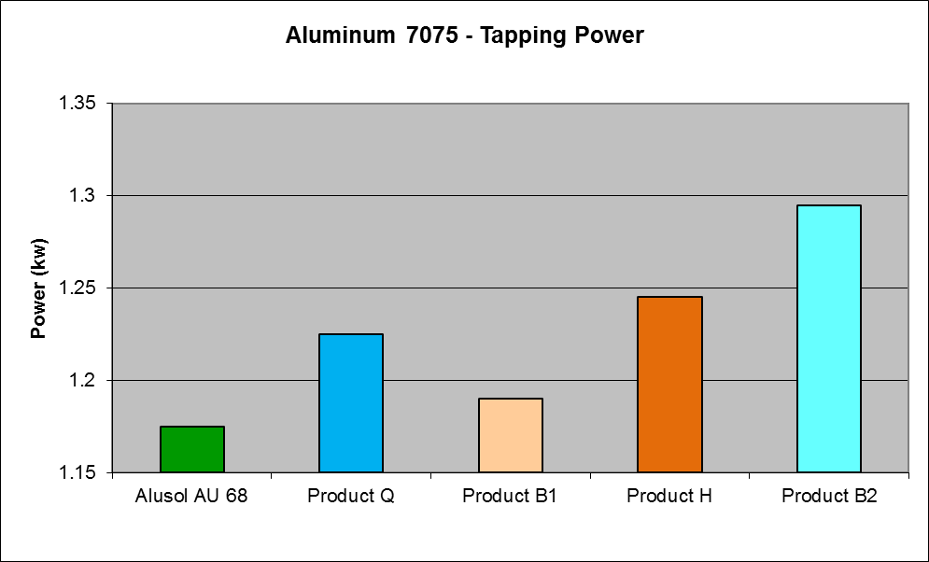
Machining Performance vs. Competition
Aluminum 7075 – Form Tapping Power Draw

Slide 47
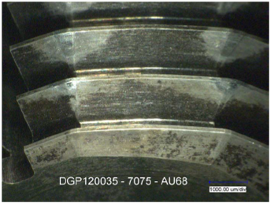
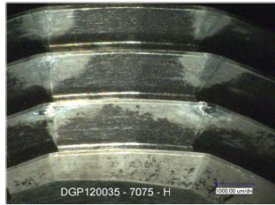
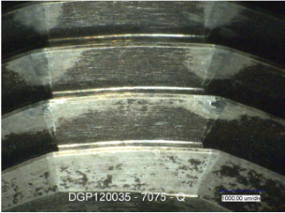
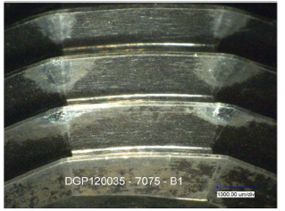
Machining Performance vs. Competition
Aluminum 7075 – Tool Condition
Alusol AU 68
Low built-up edge
Competitor H
Significant built-up edge
Competitor B1
Significant built-up edge
Competitor Q
Significant built-up edge

Slide 48
Coolant Usage & Waste
Extremely low usage and waste
Over 30% usage reduction vs. high performance semi-synthetic
Equates to much lower waste fluid

Slide 49
Biological Performance
* Achieved without the use of secondary amines
** Failure defined as 10⁵ bacteria and 10² fungus

Slide 50
Syntilo® 9918 – Synthetic Coolant

Slide 51
Syntilo® 9918 – Features and Benefits
Oil-rejecting synthetic cutting and grinding fluid for ferrous and non-ferrous metals
It provides pure machining performance in severe operations, such as threading
Neutral pH protects aluminum and other aerospace alloys and promotes strong operator acceptance
It produces minimal mist and generates little fluid carry-out, resulting in longer turnover rates and low product usage
Low foaming in all water conditions
Inhibits microbial growth to extend fluid life in central systems and individual sumps
Stable fluid suitable for a wide range of water conditions
Rejects tramp oils to the surface of the fluid for easy skimming
Prevents bi-metallic corrosion and is safe to use in equipment with copper, brass or bronze components
Settles chips quickly to maintain a clean working environment

Slide 52
Variocut™ D 249 – Neat Cutting Oil

Slide 53
Variocut™ D 249 – Features and Benefits
Heavy duty chlorine and heavy metal free neat cutting oil formulated with a unique combination of extreme pressure additives, lubricity additives and base oil to optimize machining performance, improve tool life and enhance surface finish in severe machining applications
Designed for use on ferrous and stainless steel materials
Advanced additive technology and EP additives give high lubricity properties and lower production costs through extended tool life
Extremely high anti-weld properties prevent burnishing or tearing wall finish; frequently eliminates need for further finishing
Low viscosity and excellent wetting characteristics reduce drag out and result in lower product usage
Good filtering characteristics and high oxidation stability increase product lifetime
Our chlorine and heavy metal free formulation improves the environmental profile and reduces disposal costs

Slide 54
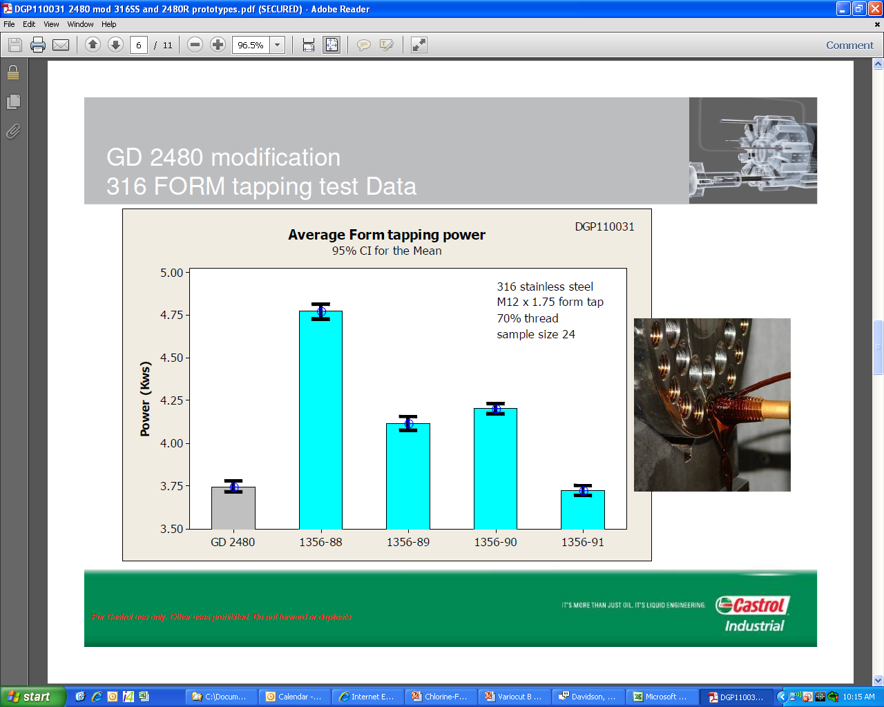
Variocut™ D 249 – Machining Performance
Chlorinated
Neat Oil
Prototype 1*
Prototype 2*
Prototype 3*
Variocut D 249
*Chlorine-free Neat Cutting Oil

Slide 55
Variocut™ G 600 HC – Grinding Oil

Slide 56
Variocut™ G 600 HC – Features and Benefits
A chlorine and heavy-metal free neat cutting oil based on the latest generation of Extreme High Viscosity Index (EHVI) hydrocracked base oils
Low oil mist and foam characteristics, even at high pressures and flow rates, can lead to a reduction in oil consumption and increased production rates
Superior additive technology helps to improve cutting and grinding efficiencies, increased tool life, surface finish and can lower overall operating costs
Low viscosity and excellent wetting characteristics can reduce drag out and helps to reduce product usage
Good filtering characteristics and high oxidation stability can increase product lifetime
Multi-metal machining using our superior additive technology may provides opportunity for product consolidation
Our chlorine and heavy-metal free formulation helps to improve the environmental profile and reduces disposal costs
Low odor, light color and low mist qualities result in high operator acceptability

Slide 57
Variocut™ G 600 HC - OEM Approvals
Kapp
Niles
Gleason Pfauter
Junker
Liebherr-Verzahntechnik
Hofler
Transor Filter
Klingelnberg

Slide 58
Performance Bio™ NC Series

Slide 59
Product Offer
A wide range of viscosity choices to fit any application
Plant-Based Neat Cutting Oils
Performance Bio NC Plus (40 cSt)
Performance Bio NC Lite (25 cSt)
Performance Bio NC Ultra Lite (15 cSt)
Performance Bio NC Ultra Lite EP (16 cSt)
Performance Bio NC Super Lite (8 cSt)

Slide 60
Benefits of Switching - Responsibility
Characteristic | Value To You
Plant-based Oil | Made from North American seed crops Aids our farm economy Reduces your carbon footprint Supports many ISO 14001 initiatives
High Flash Points | Much higher as compared to mineral oils Provides a greater safety margin Reduces the risk of fires
Low Mist and Odor | Mist/smoke is reduced by up to 4X over mineral oils Safer working conditions for operators Odor is almost undetectable / great operator acceptance
Low VOCs | Low volatility means an improved working environment Ability to meet strict regulations
Long Life / Recyclable | Formulated for long life allowing for recycling Reduction of total usage Supports “green” agendas

Slide 61
Benefits of Switching - Performance
Characteristic | Value To You
Tool Life | Exceptional lubricity can extend tool life Significant tooling savings
Cycle Time | Feed rates can often be increased Cycle time is reduced Production through-put is increased
Surface Finish | Natural lubricity along with select additives provides excellent surface finish Part quality is improved
Versatility | Compatible with all metals Suitable for a wide range of machining operations
Cleanability | Easily removed with mild alkaline cleaners Eliminates need for less safe, high pH fluids and solvents

Slide 62
Typical Flash Points
Significantly higher flash point to reduce fire risk
NC Plus @ 540ºF
General Machining Oils @ 320-390ºF
Broaching Oils @ 280-370ºF
Gun Drilling Oil @ 270-350ºF
Honing & Grinding Oils @ 230-320ºF

Slide 63
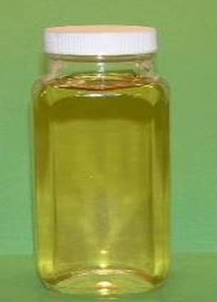
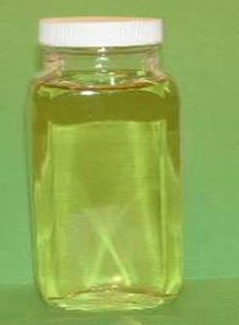
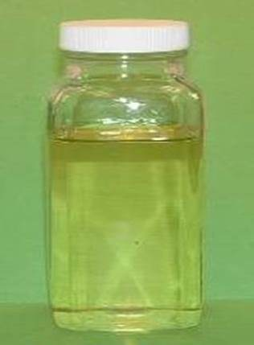
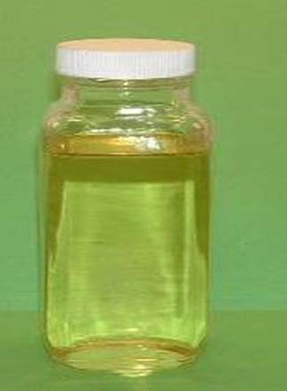
Fluid Appearance & Odor
Light color and virtually no odor create excellent operator acceptance and improved working environment
NC Super Lite
Mild Sweet Odor
NC Ultra Lite
Mild Sweet Odor
NC Lite
Mild Sweet Odor
NC Plus
Neutral Oil Odor

Slide 64
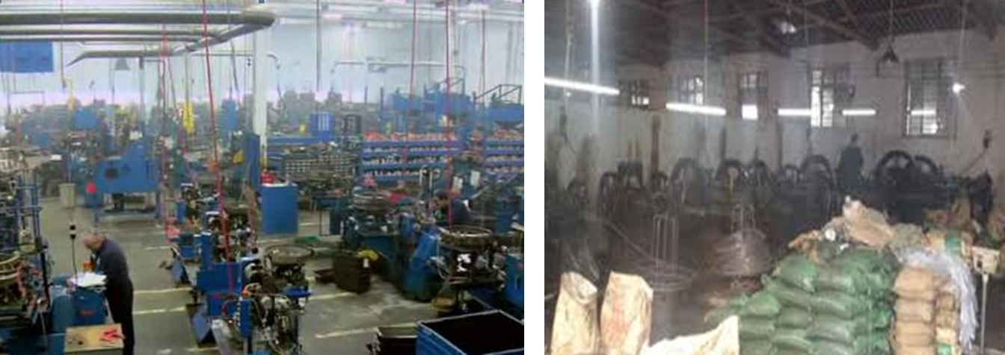
Mist / Smoke Reduction
The chemistry of the natural plant-based oils generate much lower mist and smoke vs. mineral oils

Slide 65
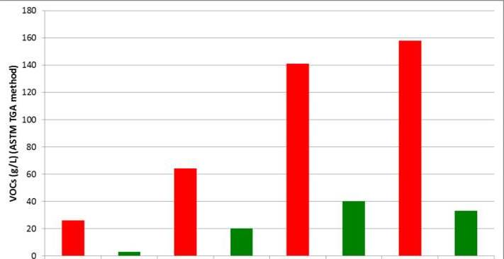
VOC Content
Performance Bio fluids have much lower VOCs* as compared to similar viscosity mineral oils
Typical
Mineral Oil
(55 cSt)
NC Plus
(42 cSt)
Typical
Mineral Oil
(27 cSt)
NC Lite
(25 cSt)
Typical
Mineral Oil
(15 cSt)
NC Ultra Lite
(15 cSt)
Typical
Mineral Oil
(8 cSt)
NC Super Lite
(8 cSt)
*Volatile Organic Compounds (VOCs) may be regulated by the EPA and state / local governments

Slide 66
High Performance Lubricants

Slide 67
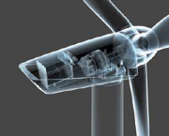

High Performance Lubricants (HPL)
A comprehensive range of world-class lubricants which deliver the performance you need in a full range of applications, including the most demanding and capital intensive, where leading edge lubrication technology is required.
Gear oils
Greases
Open gear compounds
Hydraulic oils
Fire-resistant hydraulic fluids
Compressor oils
Circulating oils
Slideway oils
Spindle oils
Chain oils

Slide 68
Optigear® 1100 - High Performance Gear Oil

Slide 69
Optigear® 1100 – Features and Benefits
Feature | Benefit | Value
TGOA additive technology | Smoothes metal surfaces Exceptional EP protection | Extended gear life Lower energy cost Reduced temp & noise
Premium hydro-treated base oil | Excellent resistance to oxidation | Longer oil life
Excellent demulsibility | High performance in the presence of water | Longer gear life Extended oil life

Slide 70
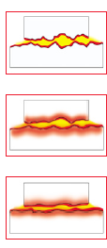
Optigear® 1100 – TGOA Additive
Advanced additive system that:
Exclusively developed by Castrol
Smoothes metal surfaces
Increases the load bearing area
Extends equipment life
Provides very low coefficient of friction
Reduces noise, vibration, and temps
Lowers energy costs
Metal surfaces are naturally rough
TGOA reacts with the surface under pressure
Surfaces are smoothed over time via Plastic Deformation

Slide 71
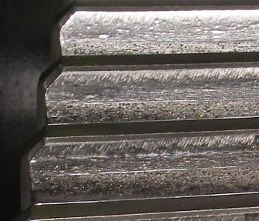

Optigear® 1100 – TGOA Additive
TGOA can stop existing wear from progressing

Slide 72

Optigear® 1100 – Demulsibility
Good demulsibility provides:
Complete separation of oil and water
Very little water remains in the oil after settling
Very little additives are stripped out by the water
Once water is removed, the oil is suitable for continued use
Poor Excellent

Slide 73







Optigear® 1100 – Applications
Gear Types
(not recommended for worm gears)
Gears with Heavy Loads, Shock Loads, Vibration, Noise, or Temp Problems
Bearings and circulating oil systems
Temps up to 175ºF
Notes:
???Can anyone name the 5 types of gears shown at the bottom??? Answer: Helical, Spur, Spiral Bevel, Double Helical (or Herringbone), Bevel
Tribol 1100 can be used anywhere an EP/Anti-scuff gear oil is recommended. It is generally not designed for worm or hypoid gearing, though.
Tribol 1100 may also be using in any type of circulating oil system.

Slide 74
Tribol® HM 943 - High Performance Hydraulic & Circulating Oil

Slide 75
Tribol® HM 943 - Fluid Characteristics
Test | Tribol HM 943
Base fluid | Group II Mineral oil
Additives | Zinc-Free AW
Viscosities | ISO 22 – 100
VI | 100 - 105
FZG rating | 12
Vickers Pump Test | Less than 10mg wear
Oxidation Resistance | 18,000+ hours

Slide 76
Tribol® HM 943 - Oxidation Resistance
Extremely long life, even at high temperatures

Slide 77

Tribol® HM 943 - Wear Protection
Excellent FZG rating of 12
Excellent 4-ball wear
Passes all major pump wear tests with flying colors
Eaton-Vickers Vane Pump Test
<10 mg of wear
Pump components appear ‘like new’ after the rigorous test

Slide 78

Tribol® HM 943 - Zinc-free Anti-wear
Environmental
Elimination of zinc in the waste stream
Performance
Extended life of hydraulic servo and proportional valves
Lower sludge formation
Coolant/water compatibility
Improved coolant compatibility (longer coolant life)
Less additive dropout & sludge in the presence of water

Slide 79
Tribol® HM 943 - Applications
Hydraulic systems
Designed for the most advanced, NC hydraulic operations
Any industrial, marine, or mobile application requiring a long lasting, mineral oil based, anti-wear hydraulic oil
Circulating systems
Lubricating anti-friction and journal bearings (centrifugal pumps, vacuum pumps, oil lubricated motor bearings, turbines, etc.)
All types of gears where manufacturers DO NOT specify an EP gear oil
Compressors
Centrifugal compressors
Flooded rotary screw compressors
Reciprocating compressors

Slide 80
Anvol™ SWX – Synthetic Fire-resistant Hydraulic Fluid

Slide 81
Anvol™ SWX Environmental Benefits
Fully bio-degradable
Easily exceeds the 60% bio-conversion of CH2/CH3 to CO2 within 28 days as per OECD 301 B
Anvol SWX 46 achieves 87%
Anvol SWX 68 achieves 75%
Zinc-free anti-wear package
Helps eliminate zinc in waste stream
Provides longer oil life in the hydraulic system

Slide 82
Anvol™ SWX - Properties
Base Fluid Polyol ester, full synthetic (no water)
Viscosities 46, 68
VI 180
AW Pack Zinc-free Antiwear
Pressure Range Up to 7500 psi
FM Approval Approved
Fire Point 701ºF, 705ºF
Autoignition Point 806ºF
Environmental Fully biodegradable

Slide 83
Fire-Resistant Hydraulic Comparison
Anvol SWX vs. Leading Competitor Product
Anvol SWX Advantages
Test | Method | Castrol Anvol SWX | Competitor Q
Viscosity Grade | - | ISO 68 | ISO 68
Viscosity Index | ASTM D2270 | 176 | 215
Fluid Type | - | Polyol Ester | Polyol Ester
Factory Mutual Rating | - | Approved | Approved
Fire Point | ASTM D92 | 705ºF (A) | 680ºF
Auto Ignition Point | ASTM E659 | 806ºF (A) | 752ºF
Four-Ball Wear Test | ASTM D4172 | 0.40 mm scar (B) | 0.52 mm scar
FZG Test | DIN 51354 | 12+ | 12+
Foam Test – Sequence I | ASTM D892 | 0/0 (C) | 50/0
Air Release | ASTM D3427 | 0.5 minutes (C) | 7 minutes
Rust Test – salt water | ASTM D665B | Pass (D) | Fail
Oxidation Stability – TOST (TAN at 500 hours) | ASTM D943 | 19.81 (E) | Failed – turned to glue
Shear Test (% viscosity loss) | DIN 51350 T6 | 0.6% (F) | 20.7%
% Biodegradability | OECD 301B | 75% | unknown
Higher heat points can provide greater fire protection
Smaller wear scar indicates better wear protection for hydraulic components (like pumps)
Much improved air handling performance reduces chances for pump cavitation
Protects from corrosion even in difficult environments
Much better oxidation resistance leads to longer oil life, component life, and less sludge/varnish
No polymer to shear, eliminating fallout and filter plugging

Slide 84
Oxidation Resistance - ASTM D 943
20
15
10
Competitor Q
Castrol Anvol SWX
TAN increase
(mgKOH/g)
5
0
0
75
150
225
300
375
450
Increased TAN causes:
Sludge
Varnish
Poor valve performance
Poor seal compatibility
Short oil life
Lower fire resistance
Time (hrs)
Oxidation spikes, eventually turning to glue
Sludge, varnish, and acid increase rapidly

Slide 85
Oxidation Resistance - ASTM D 943
Competitor Q
Castrol Anvol SWX
Sample turns glue-like and hard
Sample remains fluid and clear

Slide 86

Wear Protection Tests
Major pump OEM tests
Eaton-Vickers and Denison
Anvol SWX passes all of these
Four-ball wear test
Common test for wear protection of lubricants
See comparison chart
FZG
Test designed for EP gear oils but can demonstrate the high protection of hydraulic oils
Anvol SWX achieves the highest level in this test (12+)
Anvol SWX

Slide 87
Shear Stability - VW Shear Test
Competitor Q
Castrol Anvol SWX
Remaining Viscosity
Polymer shear causes:
Reduced viscosity
Poor protection for pumps, valves, and cylinders
Filter plugging
Sludge
Time (hrs)
Polymer shears over time
Viscosity and protection are lost

Slide 88

Fire-resistant Fluid – Safety tips
Fire-resistant fluids are not fire-proof
All fluids will burn in the right conditions
Even the glycol portion of water glycol is flammable - once the water boils off
Risk assessment must be completed to determine:
Necessary mitigating actions/equipment
Type of hydraulic fluid required
Need to know:
How can the fluid escape?
What are the ignition sources?
Who/what will be affected?

Slide 89
Tribol® SW 1066 – High Performance Slideway Oil

Slide 90
Tribol® SW 1066
Feature | Benefit | Value
Excellent coolant compatibility | Demulsifies well from coolant | Longer coolant life Extended tool life Improved part quality
Exceptional wear protection | Long slideway and ball screw life | Extended equip. life
Excellent corrosion protection | Reduced corrosive wear on ways | Extended equip. life
Tackiness additive | Resists coolant wash | Longer oil life

Slide 91
Low Coolant Entrainment
Much lower entrainment, especially in Castrol coolants
(formulated for excellent compatibility)
Entrainment in Castrol Alusol series coolants
Notes:
Castrol Symmetry lubricants one-half to one-quarter the detrimental effects on Castrol ALUSOL series cutting and grinding fluids as competitive lubricants.

Slide 92
Key Benefits of Low Entrainment
Improved Part Quality
Increase metalworking fluid performance
Lower temperatures at the point of cut
Reduce “burrs” on parts
Reduce or eliminate “smut” build-up on tools
Reduced Tooling Costs
Reduce premature dulling and breaking of tools
Longer cycles on tools before re-sharpening is required
Lower Coolant Costs
Reduce biocide and chemical usage
Longer sump life
Fewer change-outs and reduced treatment system load
Environmentally friendly
Non-zinc; no heavy metals
Notes:
These compatible fluids can improve productivity and part quality by increasing metalworking fluid life and performance. Further, the reduction of “smut” build up on tools can eliminate burrs on parts.
At the same time……

Slide 93
Improved Wear Protection
Low coefficient of friction leads to reduced friction and wear
Maximize machine speeds
Exceptional stick/slip ratio
Lower coefficient of friction
Hold tighter tolerances
Reduced chattering
Reduced wear
Notes:
Competitive testing of Tribol 1066 shows coefficients of friction 20 to 40% lower than the leading way lubricants. This translates to less metal-to-metal contact and less energy to move pallets and carriages.

Slide 94




Unsurpassed Rust Protection
Reduced corrosive wear and improved maintenance costs
40 hours 96 hours 40 hours 96 hours
LEADING COMPETITOR TRIBOL SW 1066
Notes:
Castrol developed a more severe version of the standard ASTM D 665 rust test to better simulate way conditions. This is of particular importance when using synthetic (water-based) cutting and grinding fluids. Results show the technologically advanced chemical system used in Tribol 1066 provides superior rust protection.
The leading way oil begins rusting within 8 hours and severe rusting happens within 24 hours. The next best competitor begins rusting within 16 hours. In contrast, Tribol 1066/68 protects the pins for up to 6 days with no signs of rust.

Slide 95
Aircol™ SR – Long Life Synthetic Compressor Oil

Slide 96
Aircol™ SR - Properties
Base Oil | Polyalphaolefin (PAO)
ISO Viscosities | 32 | 46 | 68 | 100
Viscosity Index | 137 | 137 | 142 | 142
Pour Point | -54°C | -54°C | -54°C | -48°C
RPVOT | 4500 min. | 3000 min. | 3000 min | 3000 min.
FZG fail stage | 8 | 9 | 9 | 9
Additive Package | Anti-Wear (zinc-free)

Slide 97
Aircol™ SR – Features and Benefits
Fully synthetic, PAO compressor and circulating oil
Excels in rotary screw compressors
Excellent for pumps, non-EP gear applications, bearings, and high temp circulating fluid applications
Features | Benefits
Excellent oxidation stability | Increased oil life in most systems – typically up to 8,000 hours
Very low deposit formation | Extends the life of filters and separators
PAO base fluid | Good compatibility with seals and mineral based fluids

Slide 98
Competitive Comparison
Exceptionally long life, even against the competition

Slide 99
Molub-Alloy® 860 ES – Heavy Duty High Performance Grease

Slide 100
Molub-Alloy® 860 ES - Properties
Base Fluid | Highly refined mineral oil
Base Fluid Viscosities | ISO 150, 220, 460
Thickener | Lithium Complex
NLGI Grades | 0,1,2
Additives | Moly, oxidation inhibitors, rust inhibitors, tackiness agents
Temp Range | 10°F - 350+°F
Water Wash Resistance | Excellent
Heavy Load Capability | Excellent
High Temp Capability | Excellent

Slide 101
Molub-Alloy® 860 ES – Features and Benefits
Feature | Benefit | Value
Solid lubricants (Moly) | Excellent EP and metal protection | Extended bearing life
Adhesion | Excellent water resistance | Longer grease life Extended bearing life
High quality base oil w/ oxidation inhibitors | Resistance to oxidation at high temps | Longer grease life Extended bearing life
Multiple base oil viscosities available | Covers almost every application | Lube consolidation Less complexity

Slide 102

Molub-Alloy® 860 ES - Applications
Range of viscosities & NLGI grades to cover every application
Heavy loads and shock loads
High temperatures
High water wash
High potential for corrosion
High grease usage areas
Wet
Hot
Rust
HEAVY
Loads
Slow to Fast Speeds

Slide 103
Molub-Alloy® 860 vs Conventional Grease
Test | Method | Molub-Alloy 860/220-2 ES | Conventional Grease
Thickener Type | - | Lithium Complex | Lithium
NLGI Grade | - | 2 | 2
Base Oil Type (A) | - | Highly Refined Mineral Oil | Mineral Oil
Base Oil Viscosity | ASTM D445 | ISO 220 | ISO 220
Dropping Point (B) | ASTM D2265 | 500+°F | 315°F
Four-Ball EP Test (C) | ASTM D2596 | 500 kg | 315 kg
Load Wear Index (C) | ASTM D2596 | 60 | Not Available
Timken EP Test, OK load (C) | ASTM D2509 | 60 lbs | 40 lbs
Copper Corrosion | ASTM D4048 | 1B | 1B
Rust Test – distilled water | ASTM D665A | Pass | Pass
Rust Test – salt water (D) | ASTM D665B | Pass | Fail
Solid Film Lubricants (E) | - | Moly, Graphite | None
Roll Stability, % change (F) | ASTM D1831 | 10% | Up to 50%
Water Washout (G) | ASTM D1264 | 4% | Up to 30%
The highly refined base oil in Molub-Alloy 860 has high resistance to oxidation and provides long grease life
The dropping point is important in medium and high temp applications
The EP and anti-wear tests demonstrate 860’s superior protection under heavy loads
860 grease is designed for maximum corrosion protection with aggressive process waters
Solid film lubricants offer another layer of protection to the bearings, preventing metal-to-metal contact under extreme loads and shock loads
Molub-Alloy 860 has exceptional roll stability performance, allowing for longer life and reduced grease usage
Resistance to water washout is exceptional even with process waters

Slide 104


Molub-Alloy® 860 vs “Premium” Grease
Test Description | Test Method | Molub-Alloy 860/460-1ES | Premium Grease
NLGI Grade | ASTM D-1403 | 1 | 1
Thicker Type | Arc-Emission | Li - Complex | Li-Complex
Fluid Type | FTIR | Mineral | Mineral
Base oil viscosity (A) | ASTM D-445 | ISO 460 | ISO 460
Four Ball EP, Welding Load (B) | ASTM D-2596 | 500 Kgf | 315 Kgf
Water Washout using plant water (C) | ASTM D-1264 | 2.50% | 3.20%
Rust Test-plant water (C) | ASTM D-1743 MOD* | Rating 3 | Rating 5
TGA @ 400°F, % loss | ASTM E-1131 | 9.90% | 16%
Thermal Stability 400°F, 4 hrs. | PL-TM-055 | Serviceable | Serviceable
Roll Stability, 100°C with 10% plant water | ASTM D-1831 MOD* | No change | No change
Antimony, ppm (D) | Arc-Emission | None | 900
Two greases have mineral base oils of ISO 460 viscosity
Molub-Alloy 860/460-1 has better EP properties which is of significant importance to shock loading applications
Molub-Alloy 860/460-1 's excellent plant water resistance & rust / corrosion inhibition are of paramount importance to increased life of equipment in a wet processing environment - see photos and water washout results
Antimony and its compounds are considered hazardous under one or more Federal, State and local regulations relating to various aspects of job safety, health, transportation and / or waste management / disposal
Molub-Alloy 860/460
Moderate rust
Premium Grease
Severe rust
*The modification used in this method is using plant water instead of DI water / rating

Slide 105
Services

Slide 106

Services
Lab Testing
Machining Test Center
Training
Application Engineering Support
Technical Help Desk

Slide 107
Lab Testing

Slide 108




Product and Marketing Support
Our main focus is to provide specialist product and technical support for lubricants and metalworking fluids under the Castrol brand with state-of-the-art analytical labs, extensive testing equipment and highly skilled technologists staff at the Naperville laboratories

Slide 109
Activity set
Routine Fluid Analysis
Non Routine Fluid Analysis
Analytical Support
Microbiology
Technical Field Support
Test method development
Customer complaints & queries
Quality related investigations
Customer product trials
Customer engagement
Troubleshooting and root cause investigations
Product launch support
Technical training
Benchmarking of competitive products
OEM support/approvals

Slide 110

Lube Oil Analysis
Viscosity - ASTM D 445
Flash Point - ASTM D 92
Copper Corrosion - ASTM D 130
Foam Test - D 892
Four ball Wear - D 4172
Demulsibility - D 1401
SRV Wear Test
SRV EP Test
Elastomer compatibility - ASTM D 471

Slide 111

Grease Analysis
Penetration - ASTM D 217
Copper Corrosion - ASTM D 4048
Roll Stability – ASTM D 1831
Four Ball Wear – ASTM D 2266
Water Washout - ASTM D 1264
Water Spray off – ASTM D 4049
Four Ball EP – ASTM D 2596
Water Spray off - ASTM D 4049
Oxidation – ASTM D 942
Drop Point – ASTM D 2265
Oil Separation - ASTMD 1742
Rust – ASTM D 1743
Emcor Rust - IP 220
Fretting Corrosion – ASTM D 4170
SRV Wear
SRV EP
Grease compatibility

Slide 112

Metalworking Fluid Analysis
Chemical
Physical
Contaminants
Acid Split (%)
Alkalinity (%)
Chlorine (%)
Fat (%)
Fatty Acids (%)
Hardness (gpg)
Inhibitor (PPM)
Lubes (%)
pH
Sulfonate (%)
Sulfur (%)
Cast Iron Chip Corrosion
Copper Corrosion
Crackle Test
Flash Point (°F)
Refractometer (%)
Viscosity @ 100°F (SUS)
Bacteria (cfu/ml)
Chlorides (PPM)
Cobalt (PPM)
Dirt (PPM)
Fungus
Tramp Oil (%)

Slide 113

Microbiological Analysis
Bacteria / Fungus total aerobic plate count
Presumptive Mycobacteria quantification
Sulfate Reducing Bacteria count
Presumptive Coliform Bacteria detection
Bacteria gram stain
Bacteria Acid Fast Stain
Suspect Microbiological residue examination
Biocide efficacy determination
Bio-resistance evaluation / comparison – MWFs
In house Bacteria/Fungus Challenge
In-house Mycobacteria Resistance Challenge
ASTM D 3694 12 day resistance
ASTM E 2275 12 day and 6 week resistance

Slide 114


Analytical Capabilities
Fourier Transform Infrared Spectroscopy (FTIR)
Identification of residues forming in an operation
Identification of foreign contaminants in a fluid
Determination if product components are present
Determination of fats/fatty material content within straight oils
Gas Chromatography (GC)
Identification of residues forming in an operation
Identification of foreign contaminants in a fluid
Determination if product components are present
Quantification of Fatty Acids and Lube concentration in aqueous samples
High Pressure Liquid Chromatography (HPLC):
Quantification of bi-metallic corrosion inhibitors present in samples
Quantification of certain biocides and fungicides present in samples

Slide 115

Routine Used Fluid Analysis
45,000-50,000 routine samples processed annually
Target turn-around-time for routine samples is 2 business days*
*From the time we receive the sample until results are reported

Slide 116
LSR (Laboratory Service Report) Analysis
Scope
Non-routine analysis
Performed as needed
Snapshot of current condition
Not a trend analysis
Benefits
Aids root-cause investigations
Helps determine corrective actions
Product properties testing
Supports efforts to achieve new business
Competitive analysis
When a competitor’s product offers a unique benefit

Slide 117
Castrol Machining Center

Slide 118




Machining Test Center
Located at the BP/Castrol facility in Naperville, IL (USA)
Castrol has a dedicated workshop with a CNC machining center and CNC lathe plus associated measuring equipment
The center is available to Castrol business units and customers worldwide

Slide 119


Machining Test Center - Capabilities
What does the machining center offer?
It gives us the capability to run metal cutting trials in a controlled environment with the flexibility to reproduce customer machining systems
What does this data provide?
Effective measure of the performance of MWF in ‘real world’ cutting operations

Slide 120


Machining Center - Measurable performance
Power/torque
Dynamometer and load cell (Kws / Ncm)
Surface finish of component
Profilometer - Ra (µm)
Tool condition
Microscopic (µm) examination
Chip condition
Microscopic (µm) examination
Ancillary fluid properties
Smell, foam, mixability, etc.

Slide 121
Machining Center - Results
How is the data used?
Generates factual data to present to customers
Provides direction on product development
Guides Marketing in product positioning
Investigate field issues
Investigate latest technology – tooling, tool coatings etc.
Generates data for Claims and Demos
Training

Slide 122




Case Study - Automotive
Measurable thread forming in camshaft - tool life and thread quality
Product A
Product B

Slide 123




Case Study - Automotive
Measurable Reaming Cylinder head - Surface finish
Poor Finish> 1.0 Ra
Good Finish~ 0.1 Ra

Slide 124


Case Study - Cast Aluminum Drill Test
Hole Finish
Product A
Product C

Slide 125


Case Study - Thread Forming
Thread Quality
Mag 25X
Product A
Product C

Slide 126
Other Services

Slide 127


Training & On-Site Support
Operator Training
In-Plant Support

Slide 128

Field Application Engineers
Team of experienced, highly knowledgeable engineers providing fundamental technical expertise and support to sales
On-site support to customers in the field
Product recommendations by application review
Troubleshooting support
Site surveys / process review
Continuous improvement projects
Value documentation

Slide 129
Technical Help Desk
Technical support desk available to TSMs, distributors, and direct customers on Castrol products and applications
Castrol product questions
Troubleshooting
Application support
Lab analysis data interpretation
Compatibility questions
+1-630-961-6562 techhelp@castrol.com

Slide 130

Thank You

